Slide 1
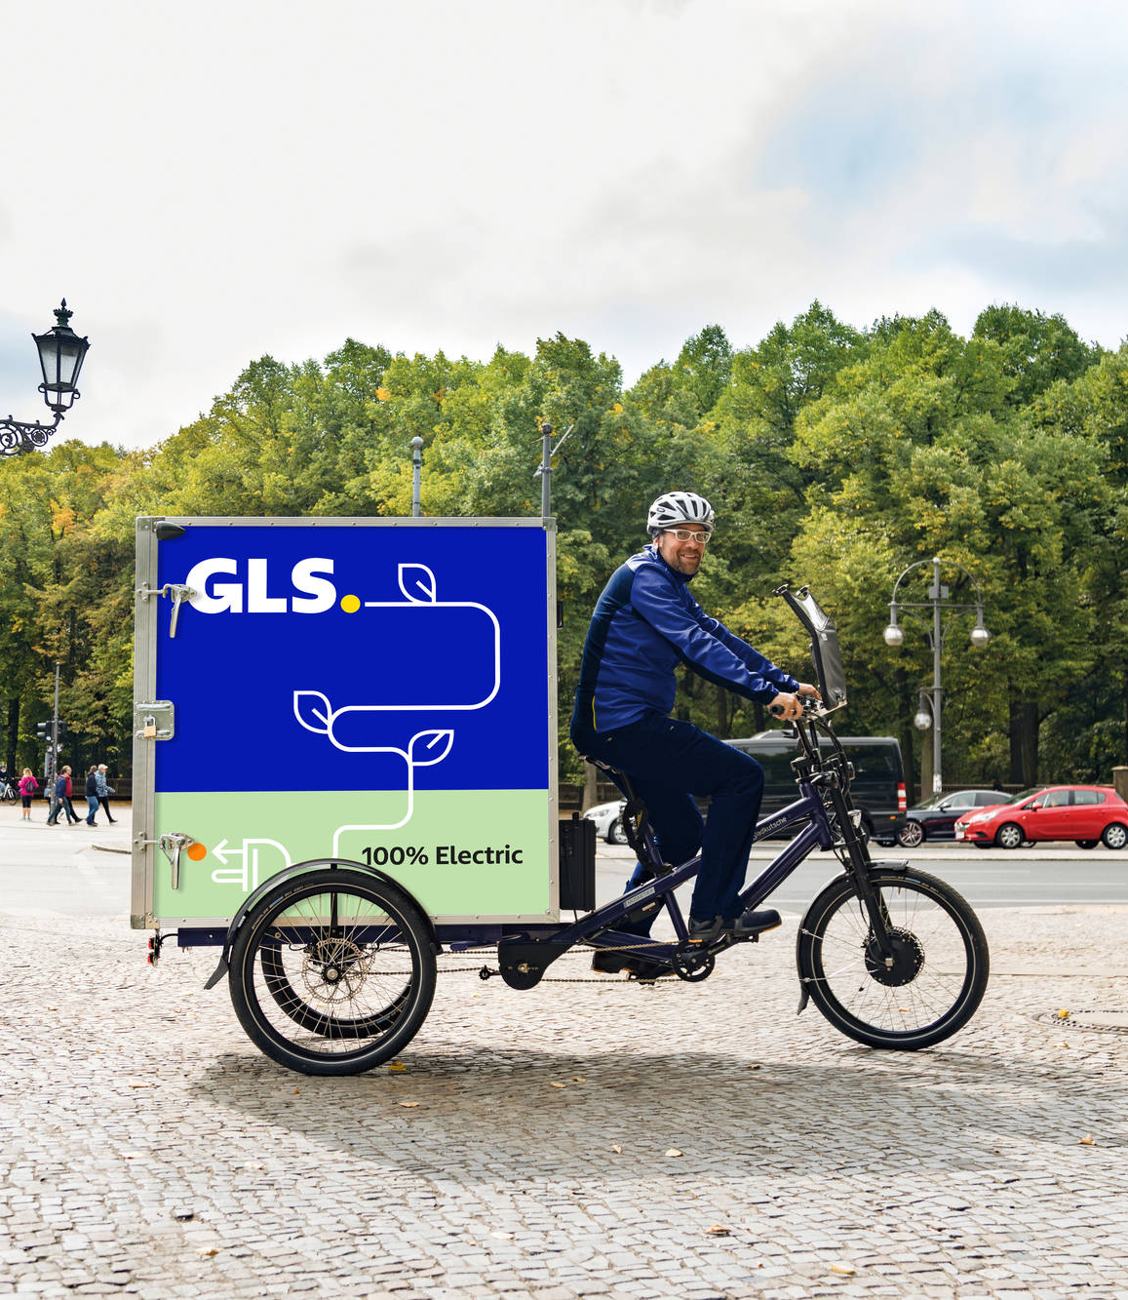
Your contribution to sustainability
In four steps to your Compensation Certificate

Slide 2
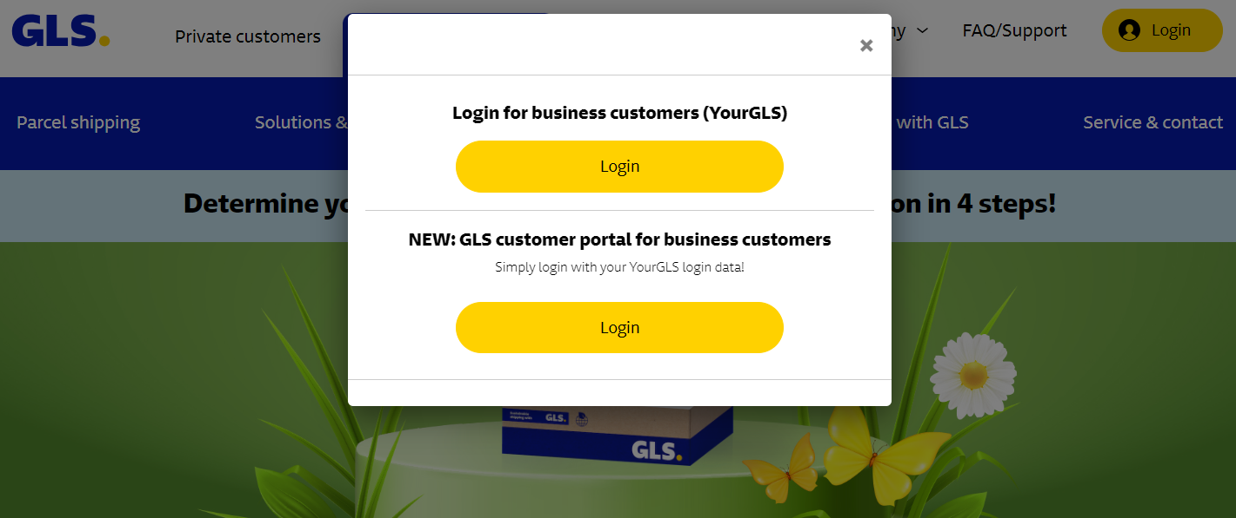
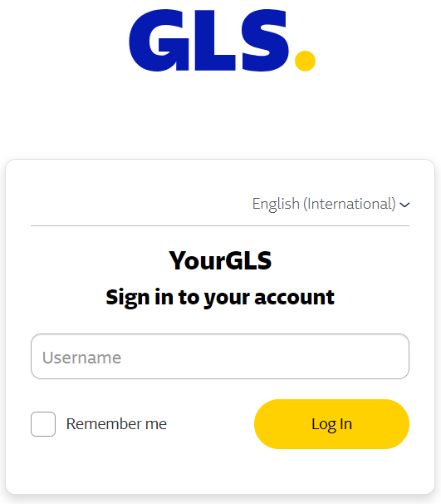
Step 1:
Login to the GLS Customer Portal
Log in to our GLS Customer Portal with your customer data

Slide 3
Step 2:
Selection of documents
Within your dashboard you will find the tab “documents”
Click on it and then select a shipper

Slide 4
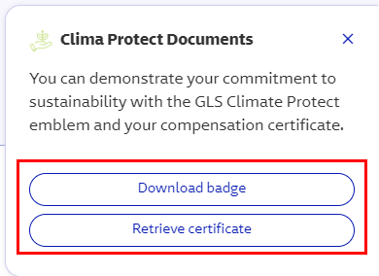
In cooperation with ClimatePartner, we additionally and voluntarily compensate the amount of greenhouse gas emissions caused by parcel transportation, business travel and the use of buildings
Step 3:
Climate Protect Documents
On the right side of the dashboard, you will find the section Climate Protect documents
Click on the "Retrieve certificate" field in the window that opens
You will then be redirected to your individual customer page

Slide 5
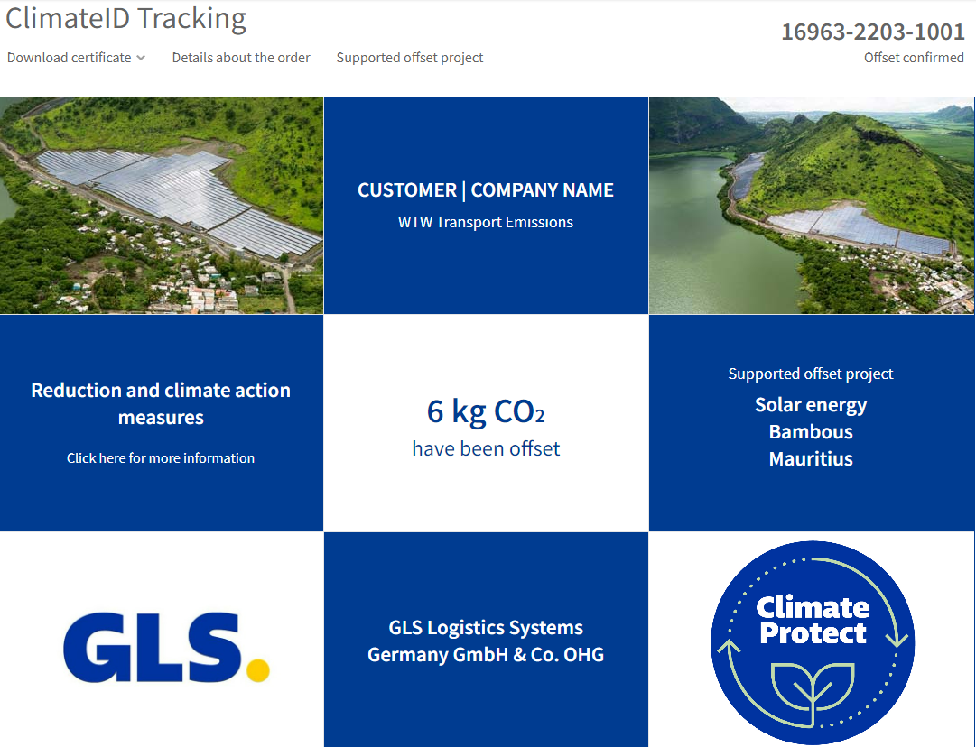
12345-1234-12345
Step 4:
Your customer page
1
On your customer page you can view and download your individual Compensation Certificate
Here you will also find more information about the climate protection projects
3
2
4
1
Your Compensation Certificate (totaled since 2022)
3
More information about the climate protection projects
Your total CO₂-Offset-history, all certificates (current and older)
4
Here you will be forwarded to the GLS Group homepage
2

Slide 6
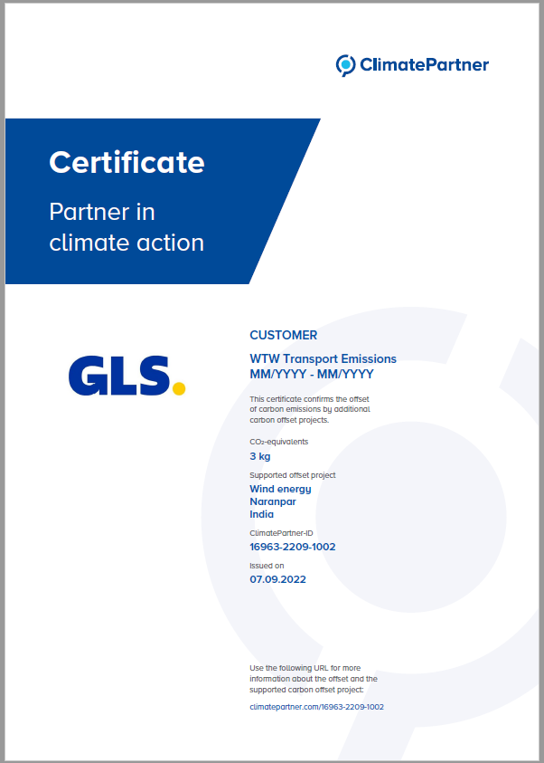
You receive annually a certificate which officially confirms your contribution to carbon compensation* through climate protection projects
Example
*Compensation of greenhouse gas emissions resulting from parcel shipping by investing into climate protection projects. Info at https://gls-group.eu/DE/en/compensation/

Slide 7
Thank you for your contribution to sustainability!

